Slide 1
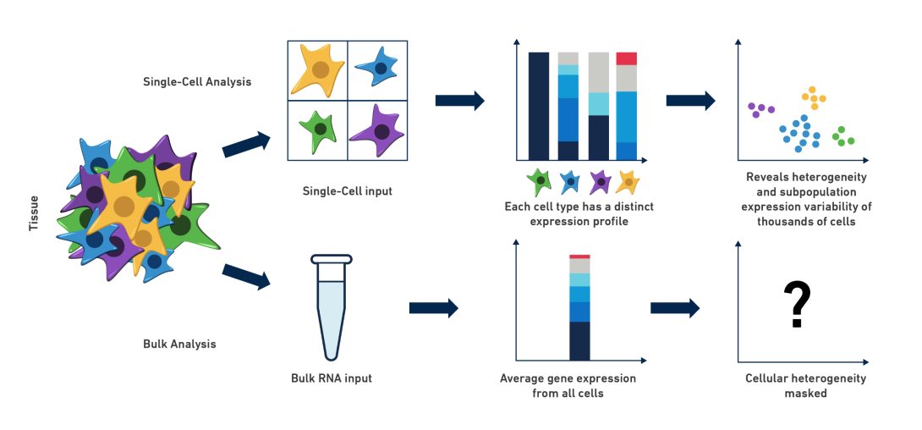
Bulk sequencing versus single-cell
Reveal further heterogeneity

Slide 2
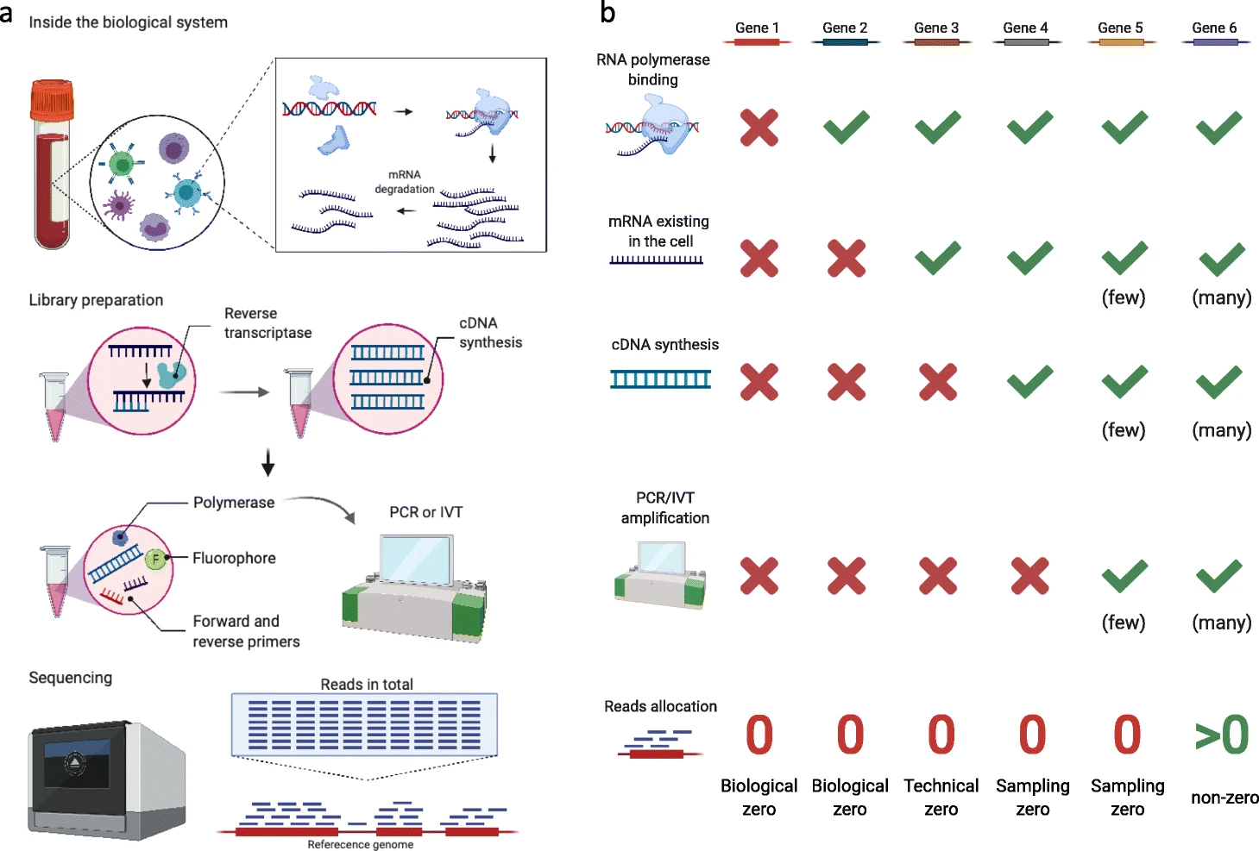
Sparsity issues – the sources, the complexities

Slide 3
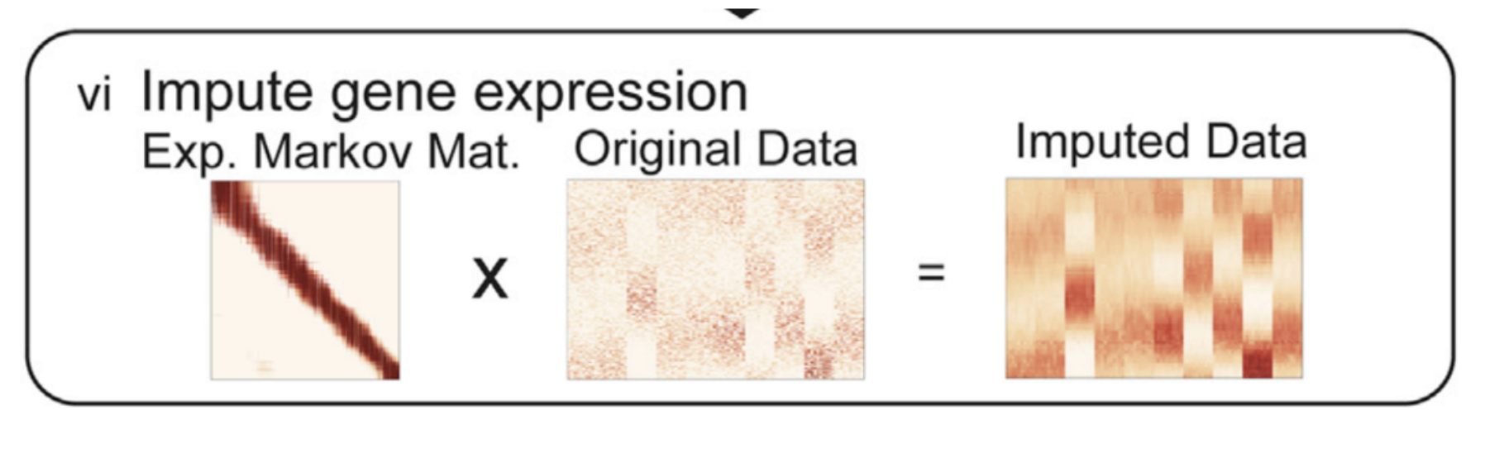
Sparsity issues – the sources, the complexities
Computational imputation
Univariate imputation (i.e. mean, median, mode)
Multivariate imputation (i.e. regression, KNN) [Borrow information from similar data]
It is debatable whether imputation would be beneficial in single-cell field
Imputation introduces artificial bias basing off of the statistical assumptions
Values that are present are sufficient for us to infer similarities between cells

Slide 4
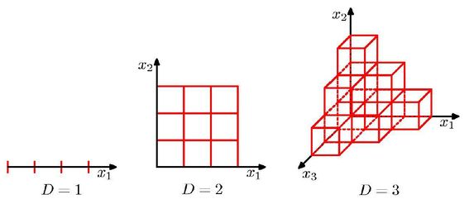
Curse of dimensionality and dimension reduction algorithms
A single-cell dataset can easily become more than 100k cells (20,000 genes * 100k cells)
Curse of dimensionality
The same amount of observations in low dimension is not sufficient to describe the same configuration (regular grid) in higher dimension space

Slide 5
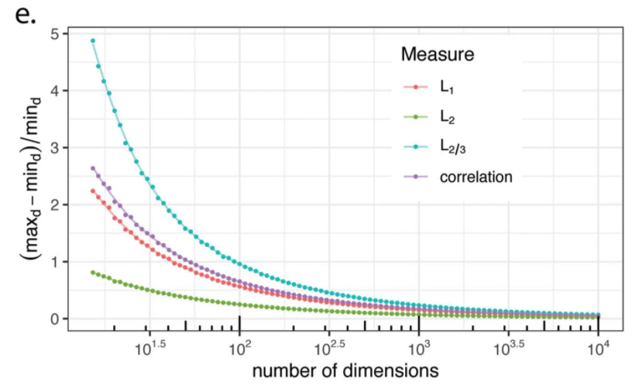
Curse of dimensionality and dimension reduction algorithms
A single-cell dataset can easily become more than 100k cells (20,000 genes * 100k cells)
Curse of dimensionality
traditional distance metrics fall short of measuring similarities

Slide 6
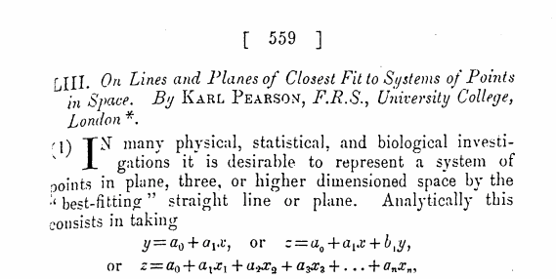
Dimension reduction algorithms - Principal component analysis (PCA)
PEARSON, Karl, 1901. On lines and planes of closest fit to systems of points in space, Philosophical Magazine, Series 6, vol. 2, no. 11, pp. 559-572

Slide 7
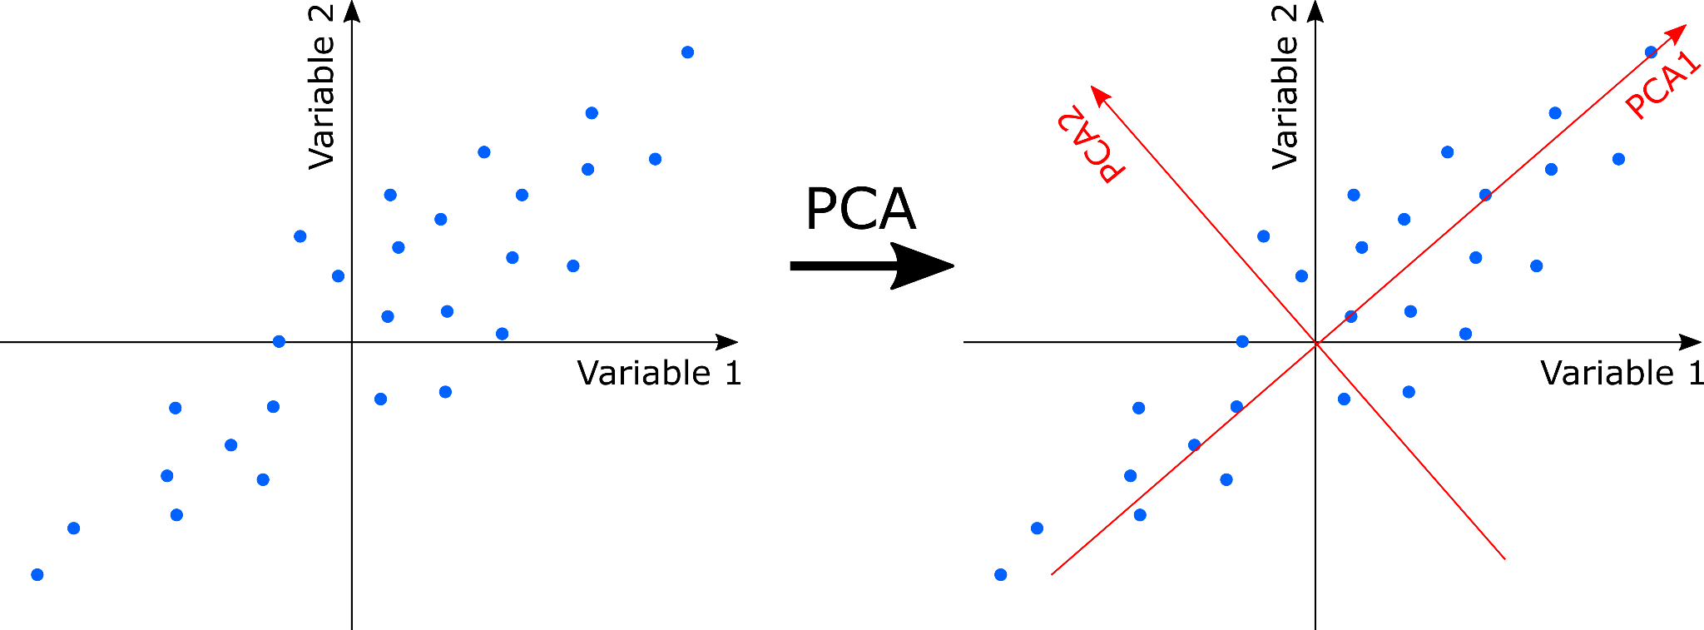
Dimension reduction algorithms - Principal component analysis (PCA)
Find orthogonal sets of axes that explain the most of the variation
https://en.wikipedia.org/wiki/Principal_component_analysis

Slide 8
Dimension reduction algorithms - Principal component analysis (PCA)
N features corresponds to N Principal Components (PC)
We only retain the top k Principal Components which consists of essential information, but discard the remaining N-k PCs as they are noises. [Dimension reduction]
Typically we can reduce the dimensions from original (20,000) to 30-50 PCs

Slide 9
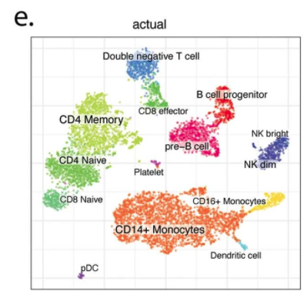
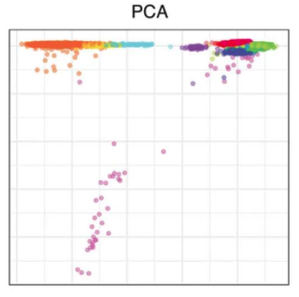
Dimension reduction algorithms - Principal component analysis (PCA)
Find orthogonal sets of axes that explain the most of the variation
What are the x-axis and y-axis in the plot?
PC2 (5%)
UMAP-Y
UMAP-X
PC1 (45%)

Slide 10
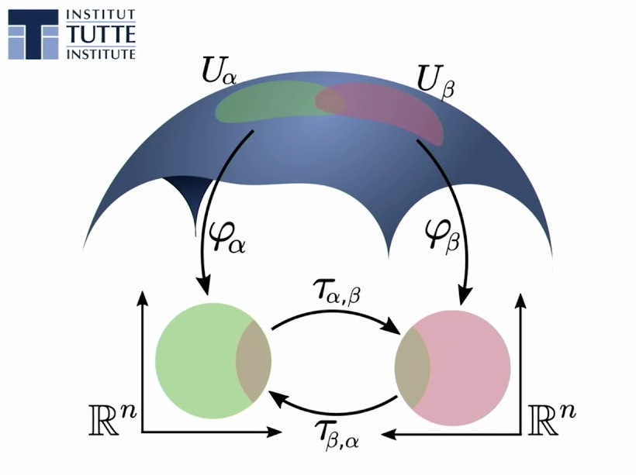
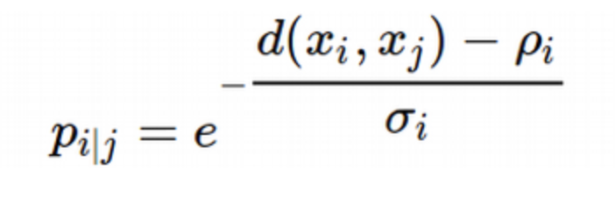
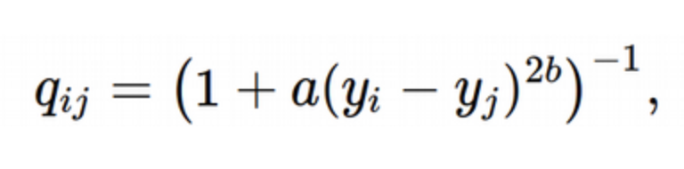
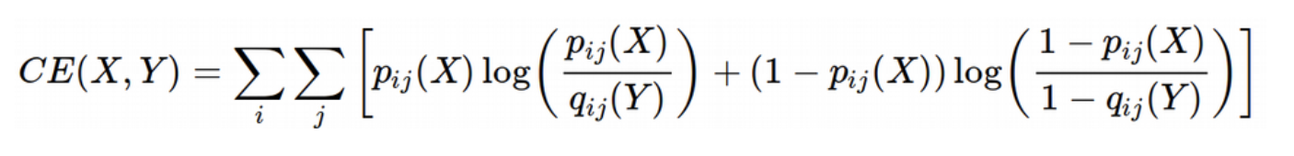
Further dimension reduction – From PCA (30 or so) to 2-3 dimension
UMAP: Uniform Manifold Approximation and Projection
30-D
2-D
Cells that are similar in the high-dimension space should be similar in the low-dimension space as well

Slide 11
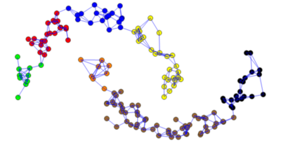
k-Nearest Neighbor (KNN) Graph to represent cell-cell similarities
Calculating pairwise distance based on traditional distance metrics on reduced PCs
Add an edge between cell A and cell B if the cell B happens to be one of the cell A’s k-nearest neighbors

Slide 12
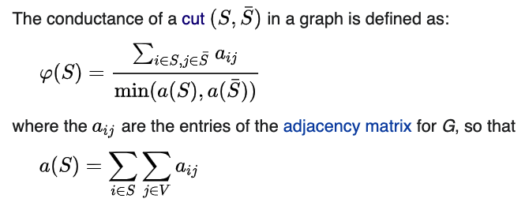
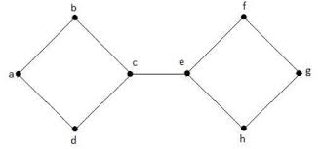
Clustering on the KNN graph to define cell populations (Spectral clustering)
Find the cuts with minimum conductance that partition the graph

Slide 13
Hands-on session

Slide 14
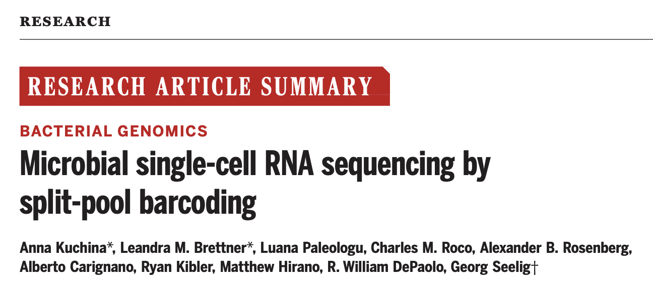

Slide 15
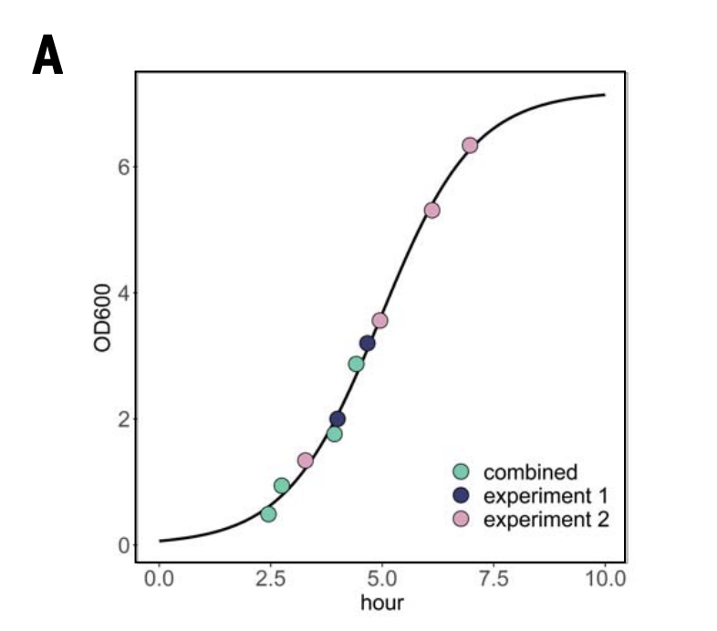
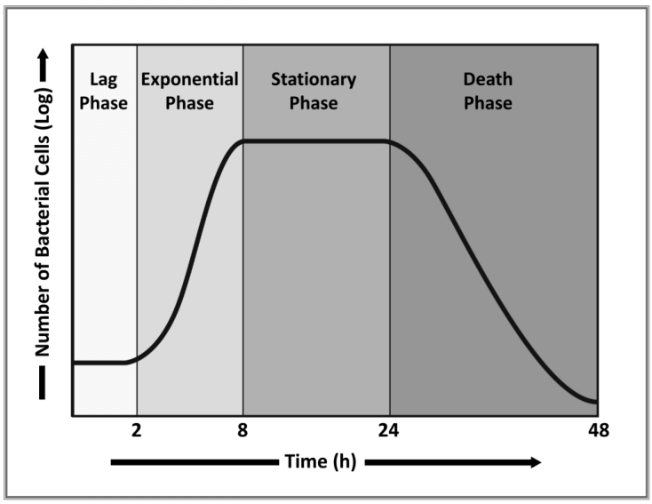
Do B. Subtilis bacteria that are in different growth stages have distinct transcriptional profiles?

Slide 16
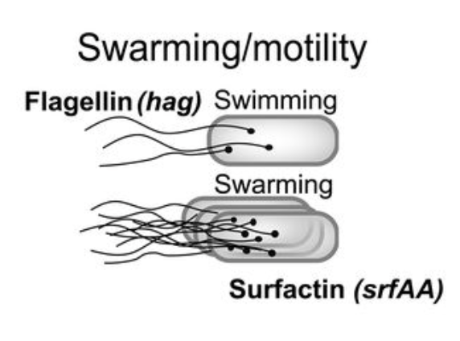
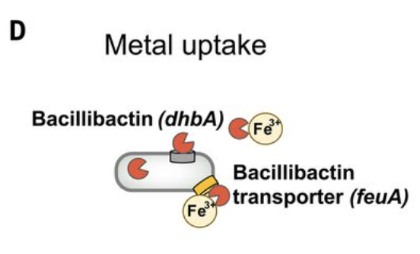
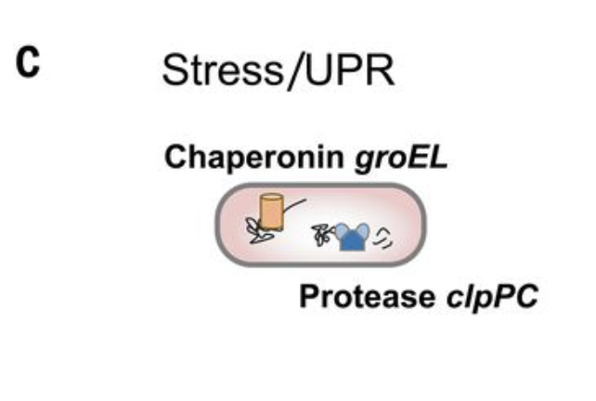
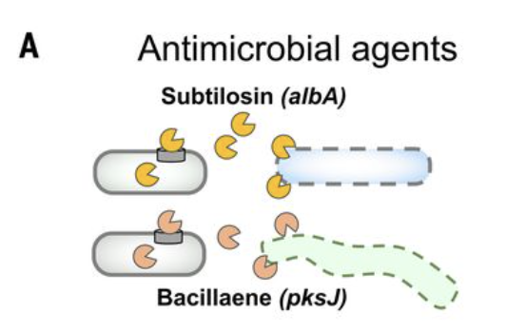
Phenotypic changes during the course of bacteria growth

Slide 17
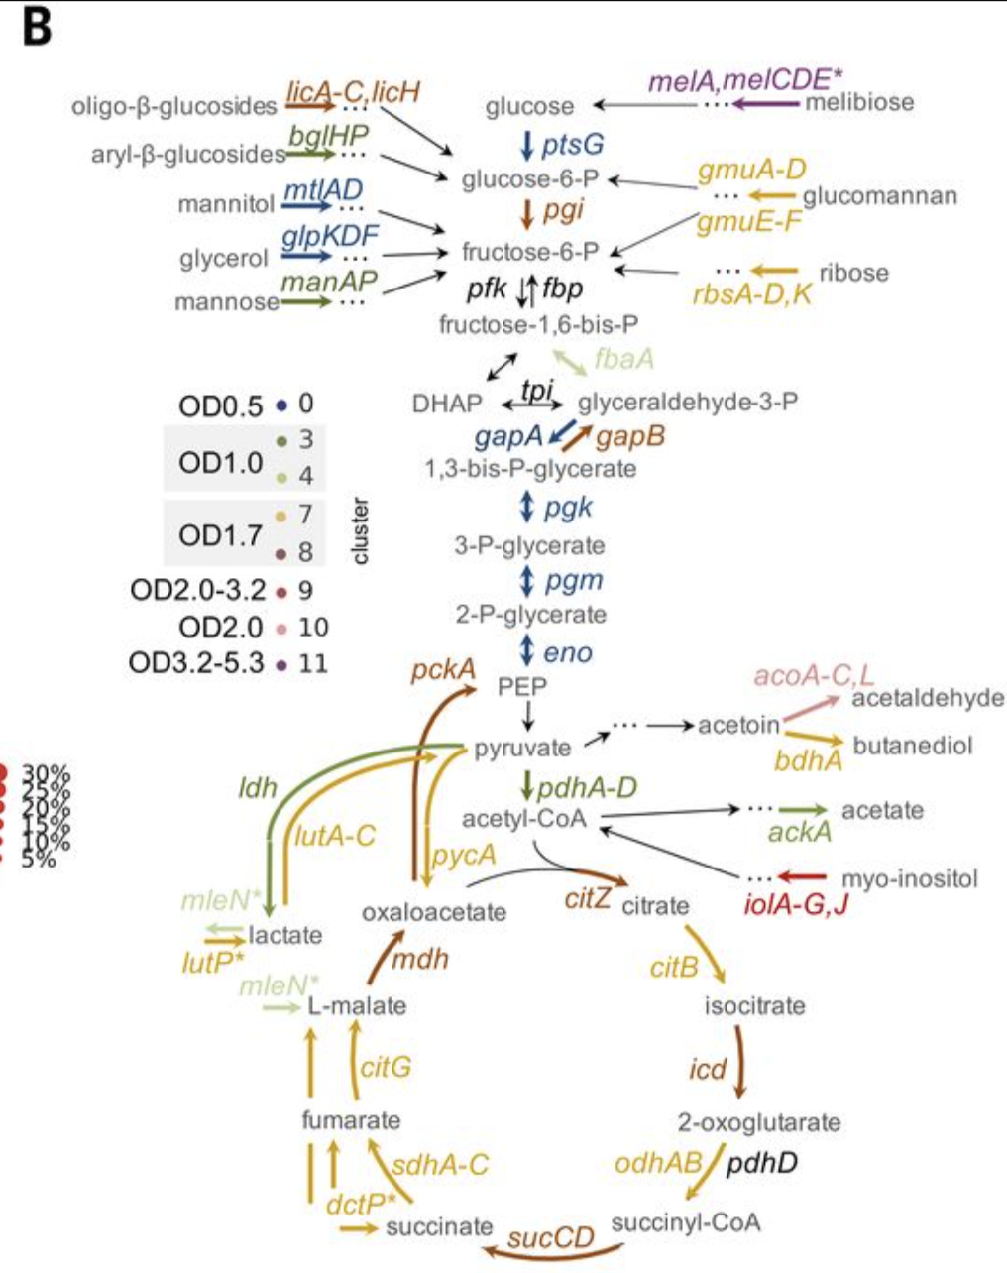
Switch of carbon catabolism pathways
Can you visualize the expression distributions of the key enzymes shown in the graph, and provide biological hypothesis?

